Slide 1
Automatic Speech Recognition
Project Supervisor : Dr. Anil Kumar Vuppala
Project Mentor: Ganesh S Mirishkar
Group 1 Team Members :
Vijay Bhasker Kodam
Varsha Loya Ravathkar
Pravalika Kommagouni
Myla Mahojjwal
Varma MRKS

Slide 2
Agenda
INTRODUCTION 3
BLOCK DIAGRAM 4
OVERVIEW OF ASR 5
DATABADE STATISTICS 6
MATHEMATICAL FORMULATION 7
METHODOLOGIES 8
TIMELINES 9
INFERENCES 10
CHALLENGES & APPLICATIONs 11,12
REFERENCES 14

Slide 3
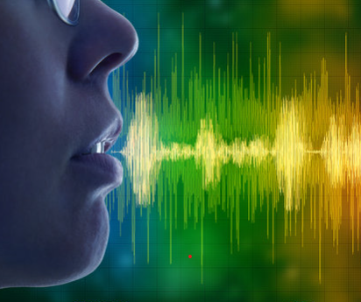
Introduction
Our Project focusses on a deployable model for Speech-text Conversion for Native Indian Language – Telugu
Automatic speech recognition is the capability of a computer system to decipher spoken words and phrases from audio and transcribe them into written text.
We choose the Kaldi toolkit for training the ASR using some hours of transcribed data.
We adopted HMM (Hidden Markov Model) and Deep learning models to achieve the Speech-To-Text functionality.

Slide 4
Overview of ASR :
BLOCK DIAGRAM
S
Speech
Acquisition
Pre-processing
Feature Extraction
Decoder
Post Processing
Acoustic Model
Lexicon
Model
Language
Model

Slide 5
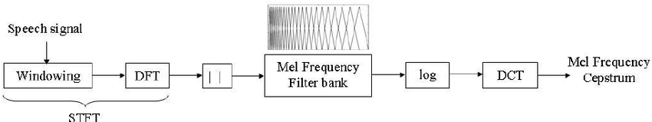
Overview of ASR
Developing a deep learning-based ASR model to improve accuracy and performance in transcribing speech in a variety of contexts and accents involves several steps. Here are some key considerations:
Data collection : Collecting a large and diverse dataset of speech samples including various accents, languages, and speech contexts..
Data pre-processing : To remove any noise or background sounds that could interfere with transcription accuracy
Feature extraction: Used Mel-Frequency Cepstral Coefficients (MFCCs) feature extraction technique.
Decoder: Choose Recurrent Neural Networks (RNNs) to handle variability in accents, languages, and speech contexts.
Training and optimization: The training process involves optimizing the model's parameters to minimize the difference between the predicted transcriptions and the actual transcriptions done using descent-based optimization algorithms, Stochastic Gradient Descent (SGD).
Evaluation: Common evaluation metrics used was Word Error Rate (WER)for further refinement and optimization based on the evaluation results.

Slide 6
Database Statistics
Group 1
Language Chosen : Telugu
Train Data Size : 53 hours
Test Data Size : 6 hours
Dev Data Size : 1 hour
Facts : Telugu is the 4th most spoken language in India, having many dialects.

Slide 7
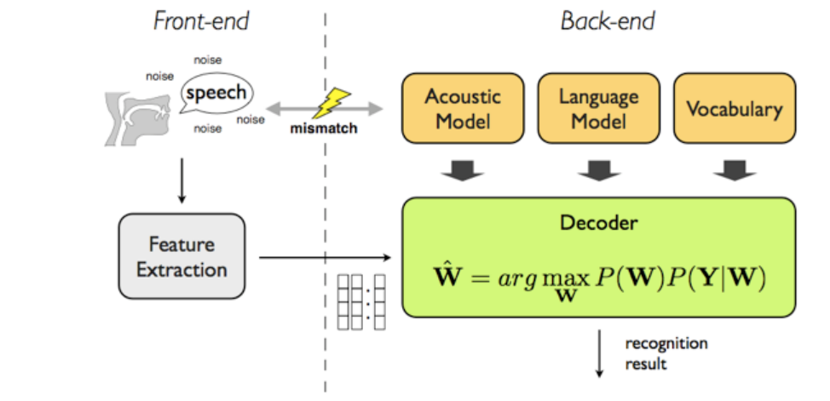
Mathematical Formulation
X denotes the feature vector derived from acoustic data and W denotes a string of words; therefore, the recognizer is capable of picking up the most preferred string.
P(W|X) denotes the probability that W are uttered given that X is detected.
The argmax function is referred to the most likely input that leads to maximum output.

Slide 8
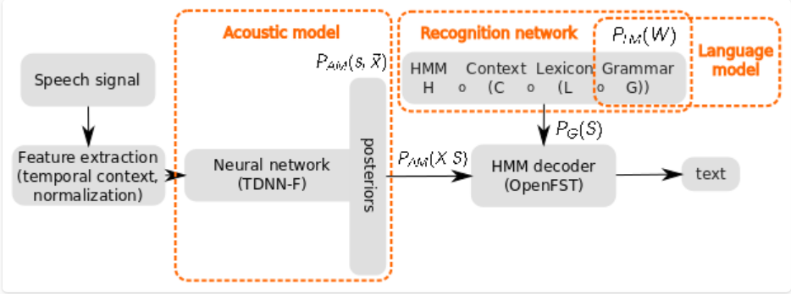
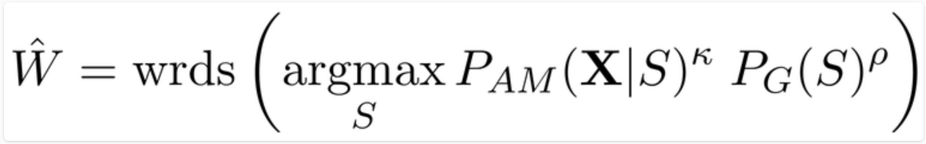
Methodologies
The central component is the HMM decoder, which explores the search space defined by the Recognition network H ◦ C ◦ L ◦ G.
Internally, the partial paths have costs computed from acoustic model scores Pam(X|S) and graph scores PG(S), where S is the hypothesized state-sequence of the partial path from the beginning of the utterance.
In the decoding formula (W) we see that we search for such state sequence S that has the maximal score, and we read the corresponding word sequence W’ by using the operator wrds(.). For optimal Word Error Rate (WER) performance, two hyper-parameters need to be identified, the acoustic scale κ and language-model scale ρ.

Slide 9
Timelines
Data Collection/Preparation
  Collect the Audio Files
  Pre-processing (Audio/Text)
Model Build/Test
  Feature Extraction
  Feature Normalization
  Build/Train the Model
  Test the Model with the Test Data
  Blind Test
Deployment
  FAST API
20th Nov – 27th Nov,2022
27th Nov,2022 – 7th Jan,2023
7th Jan – 11th Feb,2023

Slide 10
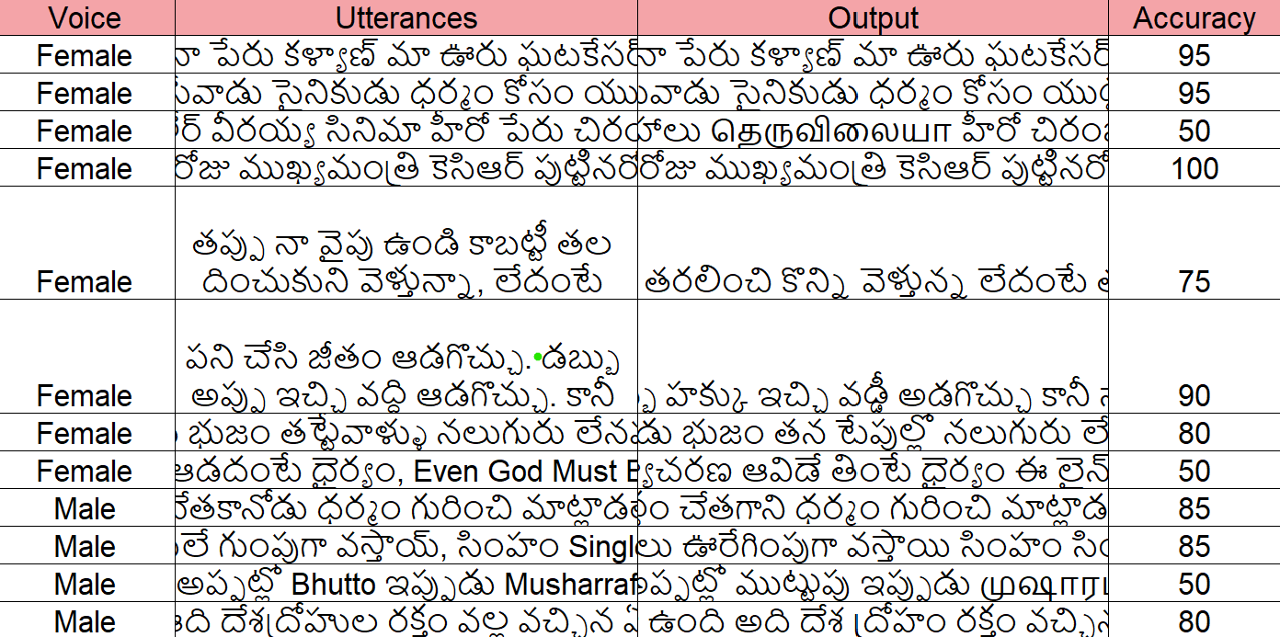
Inferences
30 instances recorded and decoded, which included the following
  Male and female voice
  Child voice
  Sentences with foreign languages
  Recordings from database
Content inferred
No. of Words(encounter-ed in the lexicon)
Consequence
Improvements
493311 words encountered
92% times correctly decoded ignoring few spell correction
Decoding error for rapid speech(fast talking) or lack of clarity
Limited time for encoding( =15 secs)
More training and updating the Lexicon with more words
Re-training for foreign languages and dialects
Good pauses between words increases accuracy
Kaldi Telugu based demo
By improving efficiency, accuracy, accessibility, and user experience, ASR technology is transforming the way we interact with technology and each other.

Slide 11
Challenges
Challenges for Telugu ASR | Challenges we faced
Huge Data Collection required. Unlike English research in speech recognition has not advanced for Telugu. No large scale speech corpus for Telugu is available. Morphologically rich language. | Team Coordination No code background

Slide 12
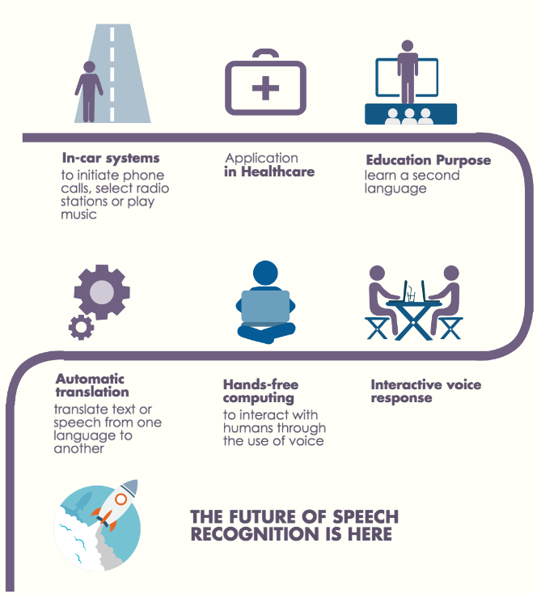
Applications
Virtual Assistants
Call Centres
Dictation Software
Transcription Services
Healthcare
Education
Gaming
Automotive

Slide 13

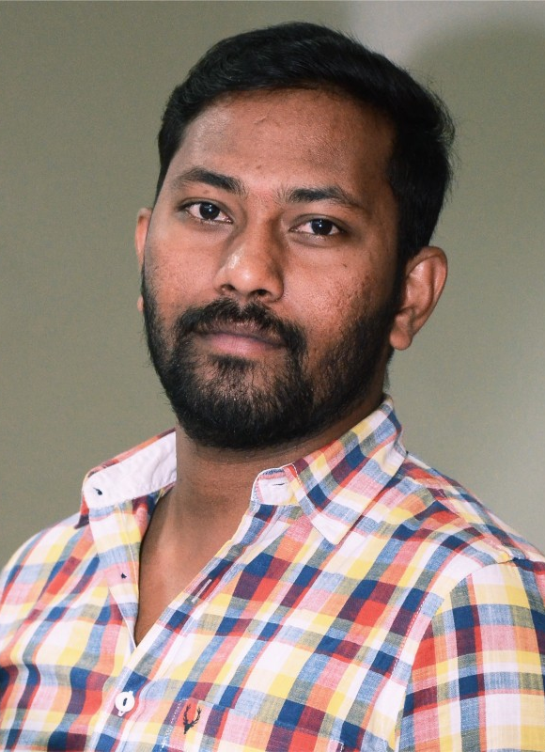

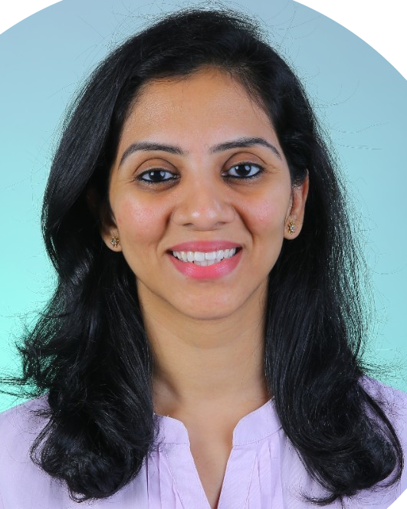
Meet our team
Ganesh
Vijay Bhasker
Varsha
Pravalika
Mentor
Team Member
Team Member
Team Member

Slide 14
References
https://www.atco2.org/news/automatic-speech-recognition-how-it-works --> slide with methodologies
https://www.prnewswire.com/in/news-releases/speech-and-voice-recognition-market-to-rise-exponentially-at-a-cagr-of-19-8-cloud-based-segment-to-emerge-dominant-says-fortune-business-insights-828795577.html
https://www.esat.kuleuven.be/psi/spraak/theses/08-09-en/MDT.php
https://www.atco2.org/news/automatic-speech-recognition-how-it-works
https://www.assemblyai.com/blog/kaldi-speech-recognition-for-beginners-a-simple-tutorial/

Slide 15
Thank you

